Slide 1
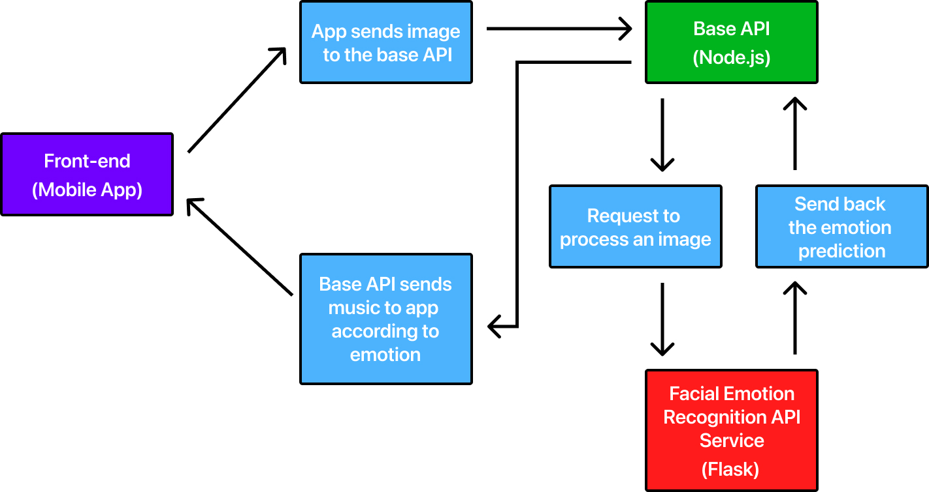
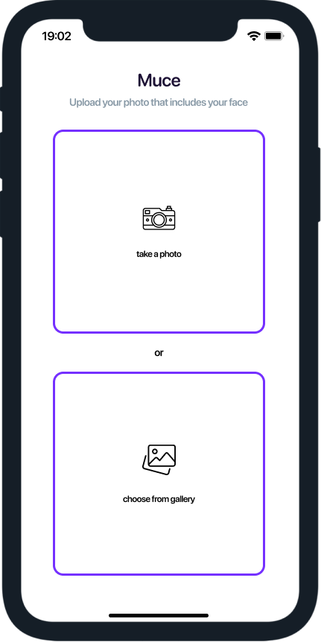
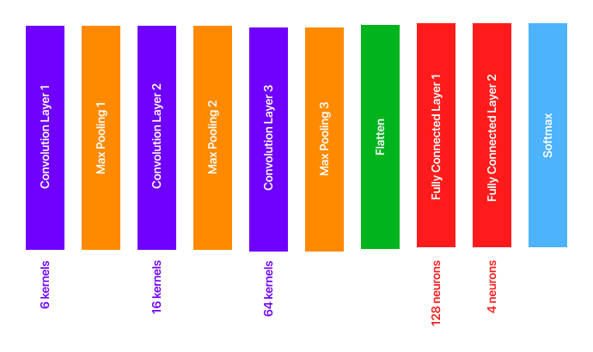
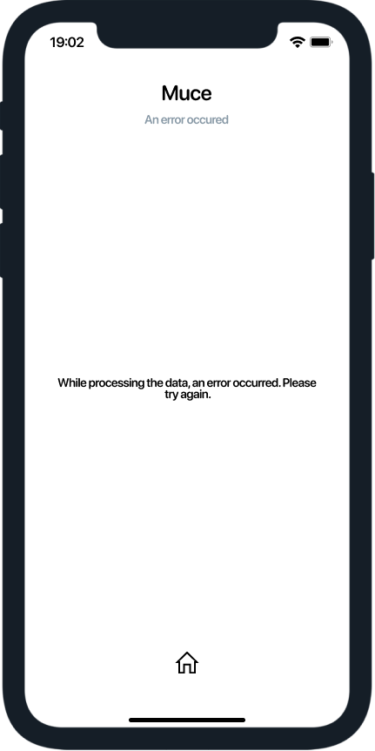
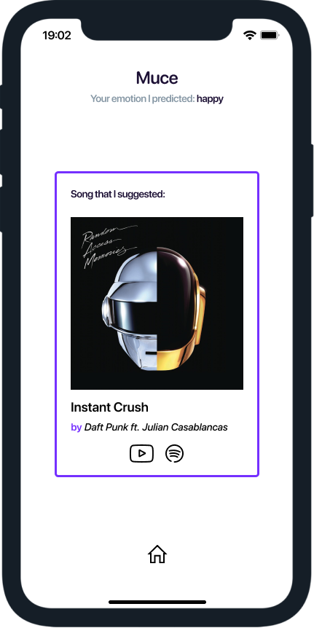
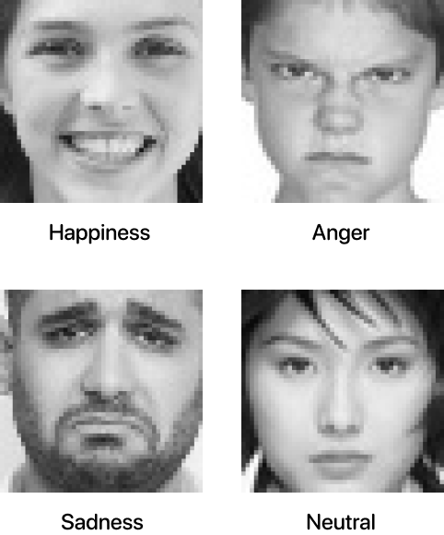
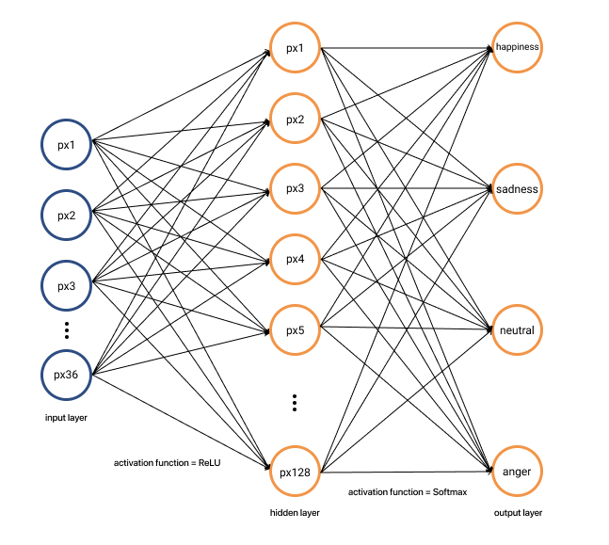
SUMMARY Muce is a mobile application that suggests music to users by predicting facial emotions using convolutional neural network(CNN) from their images.
Facial Emotion Recognition with ‘Muce’
Ali Kemal Çelenk
Computer Engineering
2020-2021 Graduation Project
PROBLEM DEFINITION
Facial emotion recognition is a significant task for the machines to understand the emotional changes in human beings. Currently, facial emotion recognition is used in many areas, for example, car safety (Automotive vendors can use computer vision technology to monitor the driver’s emotional state), effectiveness of movie scenes (The media industry can certainly improvise the content and marketing strategies knowing the sentiments of their consumers. Disney is using Emotion Analytics techniques to know the audience’s experience.), education (improving learning processes, knowledge transfer and perception methodologies), recruitment (to understand the credibility of a candidate), marketing (creating custom ads based on the client's emotional state), fraud detection (insurance companies), healthcare and more.
Muce suggests music according to users’ emotions. If the user’s emotion that has been predicted is happiness, music about happiness is suggested, if the emotion is sadness, music about sadness is suggested, if the emotion is anger, music to calm users down is suggested, and, if the emotion is neutral, music to cheer users up is suggested. So, problem that was solved is music that users may want according to their emotions at the moment is suggested.
CONCLUSION and DISCUSSION
Emotions are predicted true of approximately 7 photos from 10 photos. Also, mobile application and API services run without problem. Users can send photos and then music is suggested to them according to their predicted emotions.
INTRODUCTION This project has been studied about facial emotion recognition. For this, an algorithm using CNN has been created. This algorithm predicts facial emotions from images. Emotions that are predicted are happiness, neutral, sadness and anger. Then, a mobile application called ‘Muce’ has been created to use this algorithm in the real world. Muce suggests music to users by predicting facial emotions from their images.
SUGGESTION
Class number could be increased.
Dataset could be included more face images.
CNN model could be improved to predict emotion more efficiency.
User account could be added. In this way, the user may reach music that was predicted before.
METHODS
PROJECT DETAILS
Screenshots:
RESOURCES
Mobile Application(Front-End):
The mobile application is written in JavaScript using the React Native framework.
Technology stack: react-native, react-navigation, mobx, react-native-image-crop-picker, svgr, styled-system, styled-components, axios.
Link:
Github repository: https://github.com/alikemalcelenk/MuceMobile
Muce API:
The base API is written in JavaScript with Node.js using the mongoose framework.
Technology stack: express, mongoose, multer, joi, swagger, mocha, chai, request, nodemon, cors.
Links:
API base URL:
https://muce-api.herokuapp.com
API documentation:
https://muce-api.herokuapp.com/api-docs
Github repository: https://github.com/alikemalcelenk/MuceAPI
Facial Emotion Recognition API Service:
The facial emotion recognition API service is written in Python using the Flask and Keras frameworks.
Technology stack: tensorflow, keras, flask, opencv-python, numpy, sklearn, dlib, gunicorn.
Links:
API base URL:
https://muce-fer-api-service.herokuapp.com
Github repository: https://github.com/alikemalcelenk/MuceFERService
Dataset:
https://www.kaggle.com/shawon10/ckplus
(it includes this dataset mostly)
Similar Projects:
https://link.springer.com/article/10.1007/s00371-020-01859-9
https://ui.adsabs.harvard.edu/abs/2021InPhT.11203594L/abstract
Figure 1 - Data Flow Diagram for Muce
Muce consists of 3 important sections. These sections are mobile application, base API service and facial emotion recognition(FER) API service. The role of the mobile application is to get users' images and then to show music that was sent from the back-end. The role of the base API is to connect the front-end with the FER API service and to suggest music according to emotion coming from the FER API service. The role of the FER API service is to predict emotion according to the image sending from the base API. So, CNN model is in this section. Also, communication among the mobile app, the base API and the FER API service is done over HTTP, and the requests and responses are all in JSON format. In Figure 1, sections that were mentioned have been shown data flow among those. Informations about CNN model of Muce has been given below.
Figure 4 - Home screen has two buttons which are to choose photo includes face from gallery and to take a photo.
Figure 5 – Photo that was selected or taken is send to base API at this page.
Figure 6 – This page is to wait for loading music.
Dataset:
Figure 2 - CNN Architecture of Project
CNN accepts 48x48x3 array of pixel values (i.e., images of size 48x48 with 3 channels (RGB)) as input. CNN model consists of 3 convolutional layers, 3 max-pooling layers and 2 fully connected layers. See Figure 2 for a visual representation of the model architecture.
Figure 9 – Some faces in the project dataset.
Dataset consists of 4 classes. These classes are happiness, anger, sadness and neutral. Happiness has 421, anger has 216, sadness has 320 and neutral class has 315 face photos. Dataset has been created with randomly selected images but most of them belong to the ‘CKPLUS’ dataset.
Figure 7 – If there is an error while loading music, the user is directed to this page.
Figure 8 – On this page, Music is suggested for users according to their emotions. Users can reach Youtube and Spotify Pages of music by touching their icons.
API Documentations:
Base API
Figure 3 - Computation Graph of Project Neural Network
Facial Emotion Recognition API Service
This project’s neural network has one hidden layer and one output layer. Hidden layer has 128 nodes and output layer has 4 nodes(emotion class has 4 mood - happiness, sadness, neutral and anger). Activation functions that have been used are ReLU and Softmax. Furthermore, since CNN accepts 48x48 array of pixel values as input, normally input layer is supposed to be 2304 pixels but since CNN model has 3 max pooling layer, it decreases to 2304/4/4/4 = 36 pixels.

