Slide 1
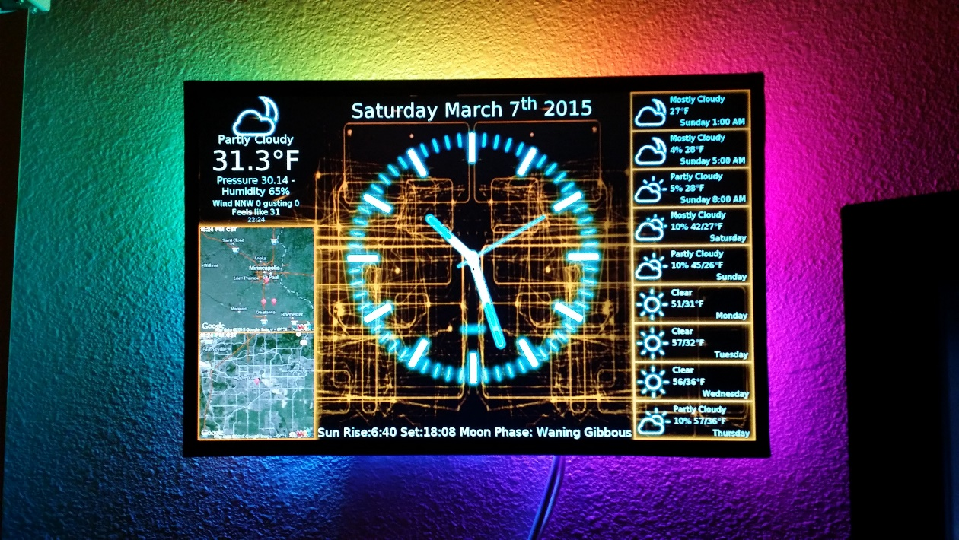
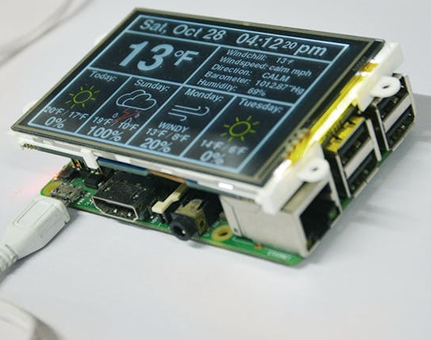
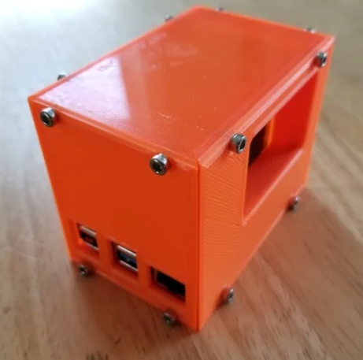
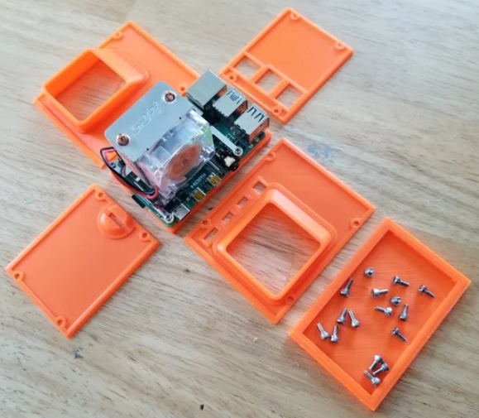
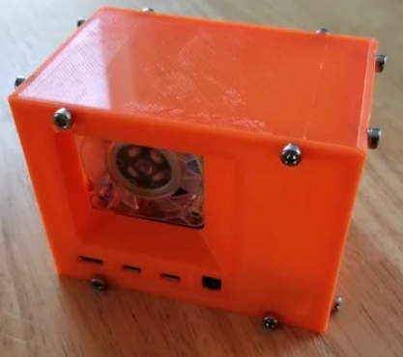
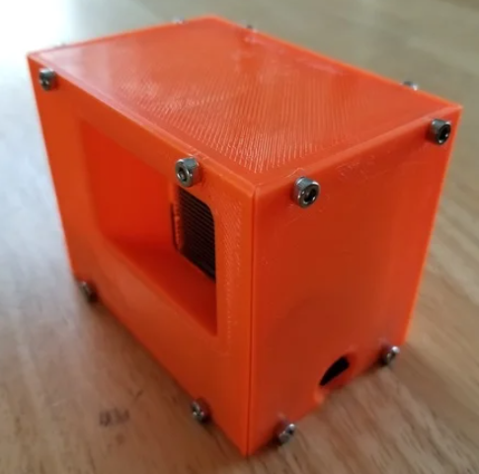
This is a project which helps a person to collect online informations to a dashboard which list these informations usefully to see them in a much more quickly and efficent way than check these informations separetely.
Daily Info Dashboard
Deha Can Akgöz
Yazılım Mühendisliği
2020-2021 Bitirme Projesi
When a people have less time to check daily online informations such as weather conditions, currencies or news headlines, this device enables to see all of them in one simple dashboard which is capable of see instantly when wake up or right before to go out or when basically in a rush for a reason it enables to get all infos in seconds rather than check them one by one.
With the help of Pyhton, Phytons' libraries, integration of APIs' from applications and websites and big advantage of Raspberry Pi's budget and space efficency, it is very possible to create many projects to collect, analyze, watch and archive online datas without need to be a big corporation or spend too much money. This new revolutionary possibilities give all of us as humans a chance to create endlessly creative and life saver solutions easily and budget friendly in our lives.
Purpose of the project is making a device which capable of gathering daily news, local weather conditions and currency informations from sources on the internet to the local network (raspberry) wth the help of phyton and APIs’.
Using a Raspberry Pi 4 8GB model, an ice tower fan for Raspberry Pi, made a 3d printed case for both of it and setup Rasbian OP on Raspberry which is a Linux based OP and then use Phyton in that system to bind codes, APIs and dashboard together in it. All these system run in a 64gGB micro SD card as Rasberry Pi's hard disk. It can connect to any screen and run.
It can be to collect and bind all datas and store it in a excel and save it before use it on a dashboard all these datas continuously, when has this feature, it gives the power of store and analyze all these datas in the future rather then just instantly able to see ad follow from a dashboard. It can also use on forecasting and machine learning in another projects.
https://hackaday.io/project/6184-piclock-a-raspberry-pi-clock-weather-display
https://www.hackster.io/4DMakers/raspberry-pi-internet-weather-station-f960c4
First find the APIs which need and then analyze the options about APIs and choose one service in them. Sign up for APIs in their sites and then get persoal API keys and integrate these keys within Phyton code which to get informations. And then find a dashboard method in Phyton libraries or from a third party dasrhboard options. And then integrate all these datas wihch is taken with Phyton codes and APIs into the dashboard and then redesign dashboard in a clean design.
REFERENCES
https://shop.sb-components.co.uk/blogs/posts/use-raspberry-pi-as-a-weather-forecaster
https://lifehacker.com/build-a-weather-reporting-news-reading-alarm-clock-wit-1631194546
https://hackaday.io/project/6184-piclock-a-raspberry-pi-clock-weather-display
https://circuitdigest.com/microcontroller-projects/raspberry-pi-based-jarvis-themed-speaking-alarm-clock
https://www.youtube.com/watch?v=-Or5jmBqsNE
https://www.youtube.com/watch?v=julETnOLkaU
https://www.hackster.io/4DMakers/raspberry-pi-internet-weather-station-f960c4
https://www.instructables.com/Raspberry-Pi-Internet-Weather-Station/
https://medium.com/@elifarslan099/python-ile-i%CC%87nternetten-veri-%C3%A7ekmek-85e54e6c25a1
https://osmanesad.medium.com/python-i%CC%87nternetten-veri-%C3%A7ekme-ve-google-spreadsheets-fa9c88377645

