Slide 1
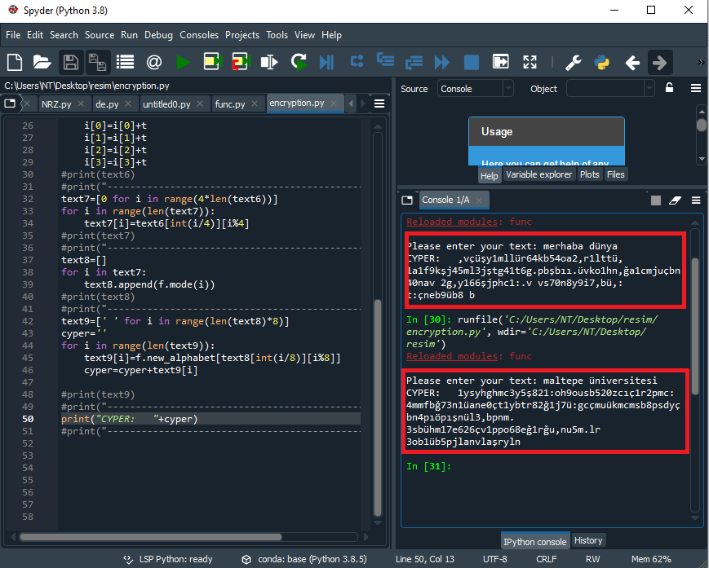
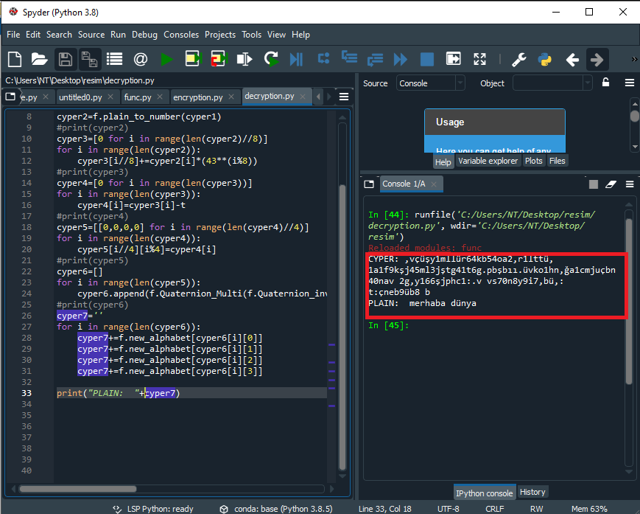
SUMMARY We examine the history of encryption from the ancient Egyptians to the present day. We explain encrytion, decryption algorithms and working principles. We create our own encryption and decryption algorithm using Python and quaternions.
Block texts of 512 bits in length can be encrypted using Octonion.
USING QUATERNIONS ENCRYPTION
AND
DECRYPTION ALGHORITHM
160704002 - NAZİM TOPAL
Computer Engineering
2020-2021 Graduation Project
PROBLEM
Today, protecting information is more important than accessing information.
Everyone wants their personal data not to be accessed by others.
Emails, accounting records, phone messages, private pictures...
Quaternions used in many engineering fields are also used in encryption.
CONCLUSION
By using the python program, the texts entered from the keyboard were encrypted with the help of quaternions and the encrypted texts were decrypted. In encryption, the text size is increase to 8 times. By optimizing the encryption key, the size of the encrypted text can be reduced.
#alfabe oluşturulması
alphabet=["a","b","c","ç","d","e","f","g","ğ","h","ı","i","j","k","l",
"m","n","o","ö","p","r","s","ş","t","u","ü","v","y","z",
"0","1","2","3","4","5","6","7","8","9"," ",".",",",":"]
len_alphabet=len(alphabet)
#alfabe kümesinden yeni alfabe oluşturulması
new_alphabet=[0 for i in range(43)]
for i in range(len_alphabet):
new_alphabet[(3*i+1)%43]=alphabet[i]
def mode(i):
a=[]
while(i>0):
a.append(i%43)
i=i//43
return a
def p_text(plain):
plain=list(plain)
#plain=list(plain.split())
r=len(plain)
if r%4!=0:
for i in range(4-r%4):
plain.append(" ")
return plain
else:
return plain
def plain_to_number(plain):
number_plain=[]
r=len(plain)
for i in range(r):
number_plain.append(new_alphabet.index(plain[i]))
return number_plain
def quad(plain_array):
t=len(plain_array)
Q=[[0,0,0,0] for i in range(int(t/4))]
for i in range(t):
Q[int(i/4)][i%4]=plain_array[i]
return Q
def Quaternion_Sum(A,B):
return [A[0]+B[0],A[1]+B[1],A[2]+B[2],A[3]+B[3]]
def Quaternion_Fark(A,B):
return [A[0]-B[0],A[1]-B[1],A[2]-B[2],A[3]-B[3]]
def Quaternion_inverse(A):
a=A[0]**2+A[1]**2+A[2]**2+A[3]**2
return [A[0]/a,-A[1]/a,-A[2]/a,-A[3]/a]
def Quaternion_Multi(A,B):
return [round(A[0]*B[0]-A[1]*B[1]-A[2]*B[2]-A[3]*B[3]),
round(A[0]*B[1]+A[1]*B[0]+A[2]*B[3]-A[3]*B[2]),
round(A[0]*B[2]-A[1]*B[3]+A[2]*B[0]+A[3]*B[1]),
round(A[0]*B[3]+A[1]*B[2]-A[2]*B[1]+A[3]*B[0])]
def split_Quaternion_inverse(A):
a=A[0]**2+A[1]**2-A[2]**2-A[3]**2
return [round(A[0]/a),round(-A[1]/a),round(-A[2]/a),round(-A[3]/a)]
import func as f
#print(f.new_alphabet)
#print("-------------------------------------------------------")
text1=input("Please enter your text: ")
text1=list(text1)
#print(text1)
#print("-------------------------------------------------------")
text2=f.p_text(text1)
#print(text2)
#print("-------------------------------------------------------")
text3=f.plain_to_number(text2)
#print(text3)
#print("-------------------------------------------------------")
text4=f.quad(text3)
#print(text4)
#print("-------------------------------------------------------")
Q= [6258452123, 1452010312, 6200254027, 9521652111]
t=1235548313091
text5=[[0,0,0,0] for i in range(len(text4))]
for i in range(len(text4)):
text5[i]=f.Quaternion_Multi(Q,text4[i])
#print(text5)
#print("-------------------------------------------------------")
text6=text5
for i in text6:
i[0]=i[0]+t
i[1]=i[1]+t
i[2]=i[2]+t
i[3]=i[3]+t
#print(text6)
#print("-------------------------------------------------------")
text7=[0 for i in range(4*len(text6))]
for i in range(len(text7)):
text7[i]=text6[int(i/4)][i%4]
#print(text7)
#print("-------------------------------------------------------")
text8=[]
for i in text7:
text8.append(f.mode(i))
#print(text8)
#print("-------------------------------------------------------")
text9=[' ' for i in range(len(text8)*8)]
cyper=''
for i in range(len(text9)):
text9[i]=f.new_alphabet[text8[int(i/8)][i%8]]
cyper=cyper+text9[i]
#print(text9)
#print("-------------------------------------------------------")
print("CYPER: "+cyper)
#print("-------------------------------------------------------")
import func as f
Q= [6258452123, 1452010312, 6200254027, 9521652111]
t=1235548313091
cyper=",vçüşy1mllür64kb54oa2,r1lttü,1a1f9kşj45ml3jştg41t6g.pbşbıı.üvko1hn,ğa1cmjuçbn40nav 2g,y166şjphc1:.v vs70n8y9i7,bü,: t:çneb9üb8 b"
cyper1=list(cyper)
print("CYPER: " +cyper)
#print(cyper1)
cyper2=f.plain_to_number(cyper1)
#print(cyper2)
cyper3=[0 for i in range(len(cyper2)//8)]
for i in range(len(cyper2)):
cyper3[i//8]+=cyper2[i]*(43**(i%8))
#print(cyper3)
cyper4=[0 for i in range(len(cyper3))]
for i in range(len(cyper3)):
cyper4[i]=cyper3[i]-t
#print(cyper4)
cyper5=[[0,0,0,0] for i in range(len(cyper4)//4)]
for i in range(len(cyper4)):
cyper5[i//4][i%4]=cyper4[i]
#print(cyper5)
cyper6=[]
for i in range(len(cyper5)):
cyper6.append(f.Quaternion_Multi(f.Quaternion_inverse(Q),cyper5[i]))
#print(cyper6)
cyper7=''
for i in range(len(cyper6)):
cyper7+=f.new_alphabet[cyper6[i][0]]
cyper7+=f.new_alphabet[cyper6[i][1]]
cyper7+=f.new_alphabet[cyper6[i][2]]
cyper7+=f.new_alphabet[cyper6[i][3]]
print("PLAIN: "+cyper7)
INTRODUCTION
In cryptography, encryption is the process of encoding information. This process converts the original representation of the information, known as plaintext, into an alternative form known as ciphertext. Ideally, only authorized parties can decipher a ciphertext back to plaintext and access the original information
Block text of 512 bits in length can be encrypted using Octonions.
SOURCES
Python programm
Anaconda Spyder
Quaternions and some features
https://en.wikipedia.org/wiki/Quaternion
https://pythoninstitute.org/what-is-python/
https://www.tiobe.com/tiobe-index/
https://www.splashdata.com/splashid/blowfish.htm
METHOD
We realized the quaternion features by writing functions on the python program. We randomly selected the encryption keys. Since has negative numbers in the quaternion multiplications formed, all the elements of the quaternion were added together with a random constant number and became positive.

